Slide 1

CodeX Energy Drink Market Research Analysis
Shruti Jain

Slide 2

CodeX Energy Drink Market Research Analysis
Insights & Strategic Recommendations
Presented by: Shruti JainProject held by: Codebasics Tools Used: SQL | Power BI | PowerPoint
Shruti Jain

Slide 3
Executive Summary
Key Findings at a Glance
Market Position
CodeX ranks 5th with 9.8% market share (980 respondents).
Target Demographics
Males (60.4%) and 19-30 age group (55%) dominate preference.
Price Sweet Spot
50-99 INR range preferred by 42.9% of consumers.
Brand Strength
Reputation (26.4%) and availability (19.9%) are key differentiators.
Growth Opportunities
Focus on Tier 1 cities and online marketing channels.
Shruti Jain

Slide 4
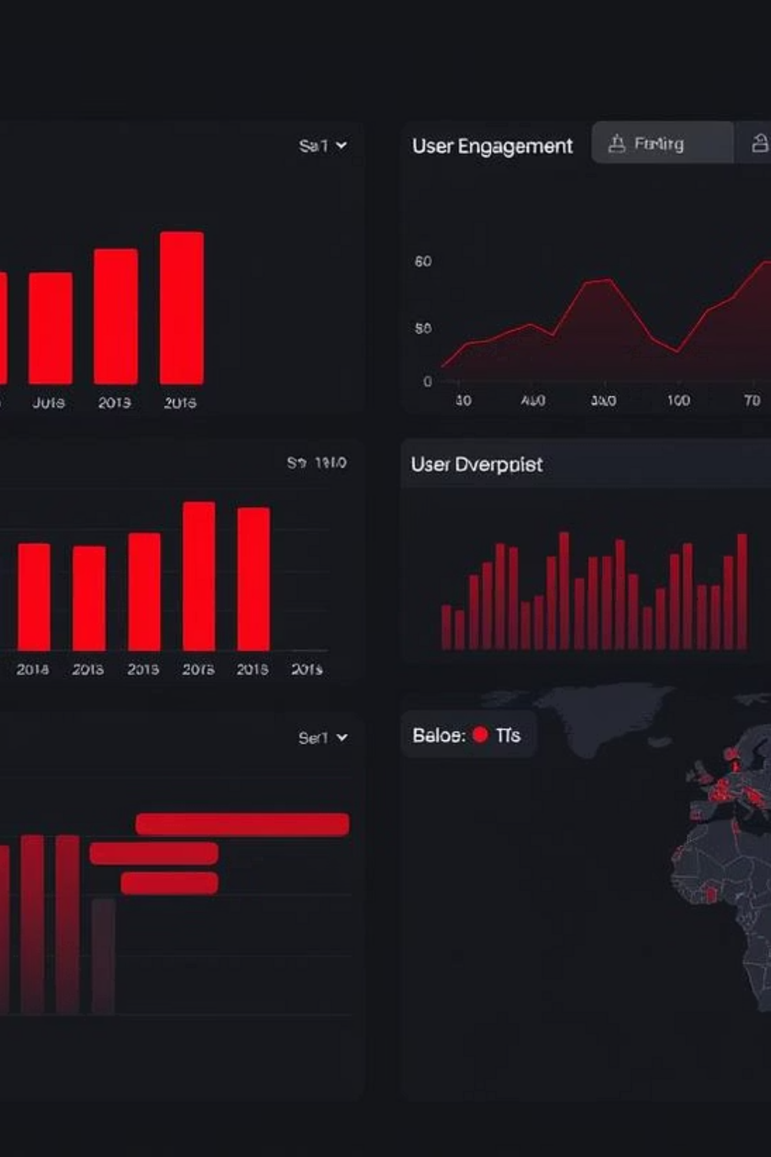
Research Methodology
Comprehensive Market Analysis
Data Collection
Analysis Framework
Sample Size: 10,000 respondents across India
Demographics & Consumer Preferences
Geographic Coverage: 10 major cities (Tier 1 & Tier 2)
Competitive Landscape Analysis
Purchasing Behavior Patterns
Data Points: Consumer preferences, purchasing behavior, brand perception
Marketing Channel Effectiveness
Brand Performance Assessment
Shruti Jain

Slide 5
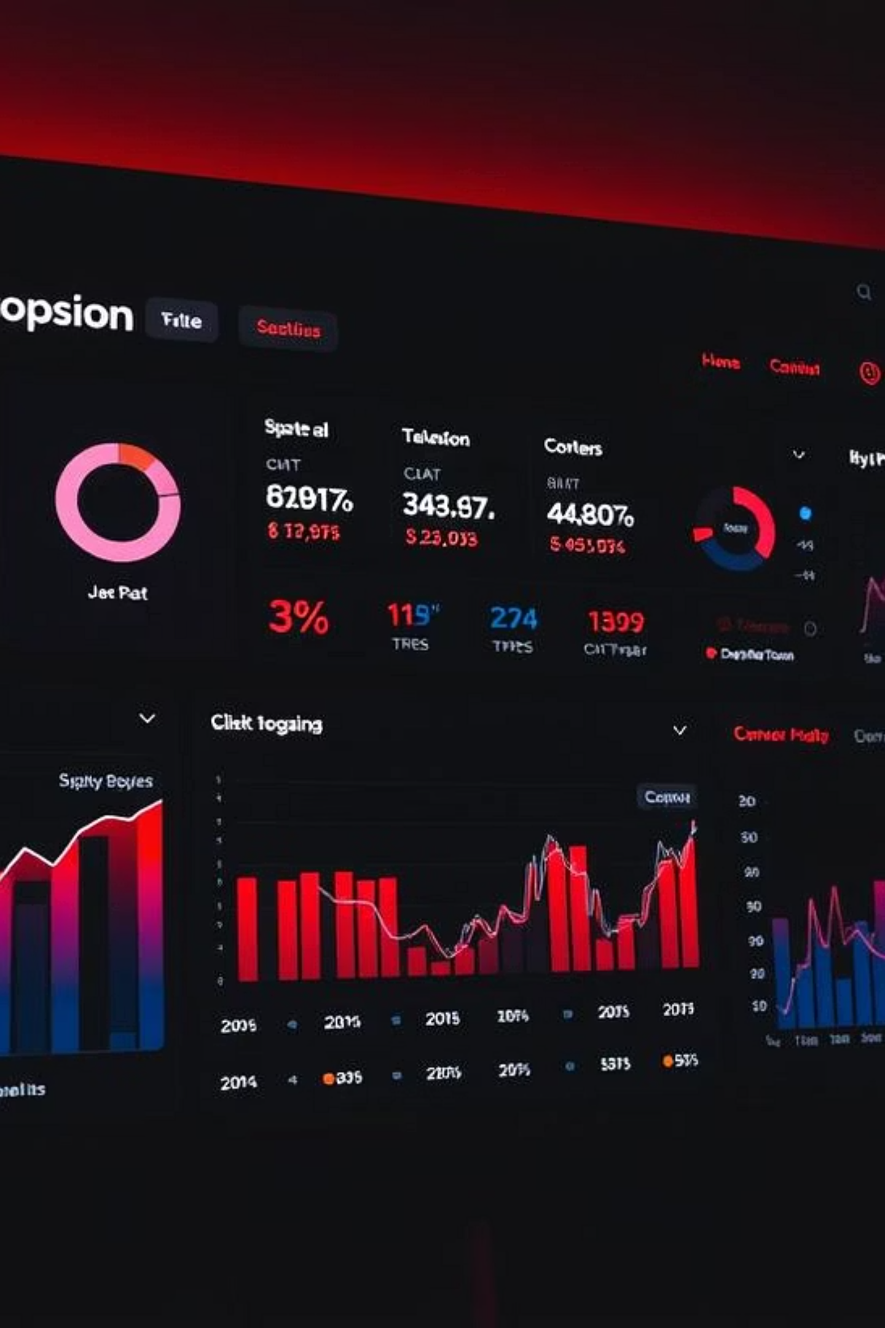
Demographics Insights
Understanding Our Target Market
Gender Distribution
Age Group Analysis
Male: 60.4% (6,038 respondents)
19-30 years: 55.2% (Highest preference)
Female: 34.6% (3,455 respondents)
31-45 years: 23.8%
15-18 years: 14.9%
Non-binary: 5.1% (507 respondents)
46-65 years: 4.3%
Key Insight: Young adult males represent our core demographic.
Shruti Jain

Slide 6
Consumer Preferences Deep Dive
What Consumers Really Want
Top Ingredient Preferences
Packaging Preferences
Price Sensitivity
Compact & Portable Cans: 39.8%
50-99 INR: 42.9%
Caffeine: 38.9%
Innovative Bottle Design: 30.5%
100-150 INR: 31.4%
Vitamins: 25.3%
Collectible Packaging: 15.0%
Below 50 INR: 10.1%
Sugar: 20.2%
Eco-friendly Design: 9.8%
Guarana: 15.5%
Shruti Jain

Slide 7
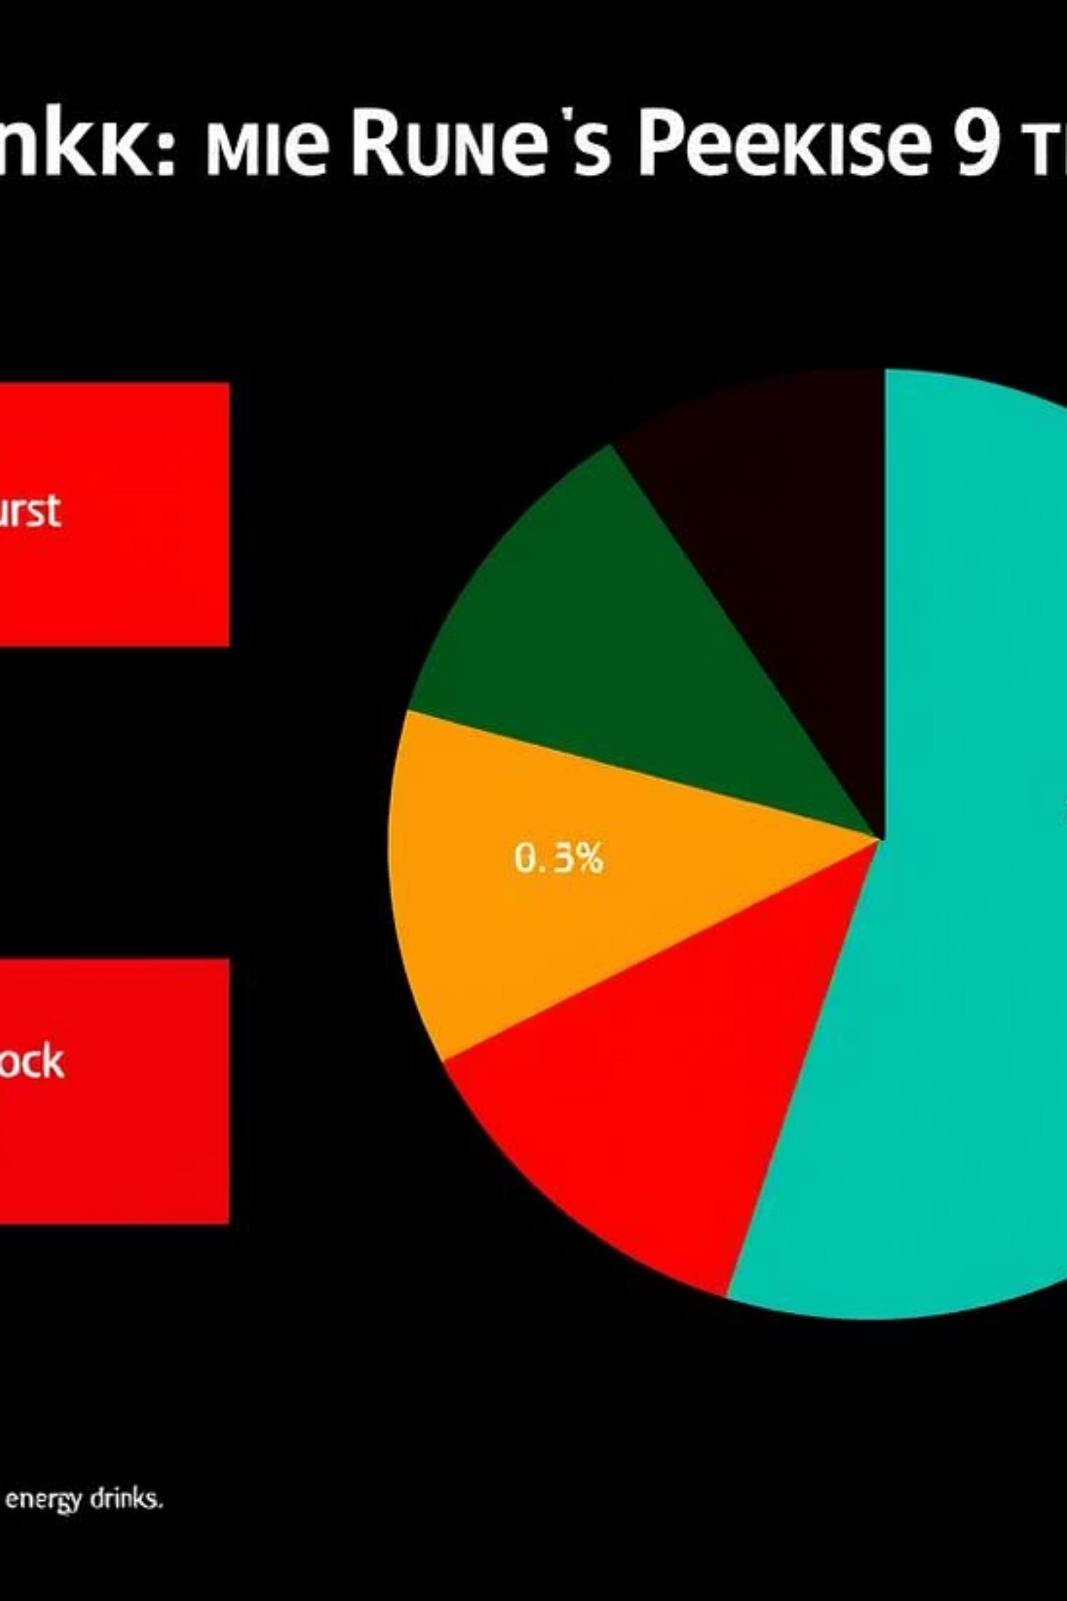
Competitive Analysis
Market Share & Positioning
Current Market Share
Taste Ratings
1
Coca-Cola: 25.4%
1
Blue Bull: 3.3/5 (Highest)
2
Pepsi: 21.1%
2
Coca-Cola: 3.2/5
3
Gangster: 18.5%
3
CodeX: 3.2/5 (Competitive)
4
Blue Bull: 10.6%
4
Others: 2.8-3.0/5
5
CodeX: 9.8%
Competitive Positioning
While CodeX has a competitive taste rating, it lags behind the market leaders in overall market share. To grow, we need to focus on increasing brand awareness and appeal.
Key Takeaways
1
Taste is not the only factor - brand reputation and availability are also key
2
Market leaders have a significant advantage in market share
3
CodeX has an opportunity to differentiate itself and gain share
Shruti Jain

Slide 8
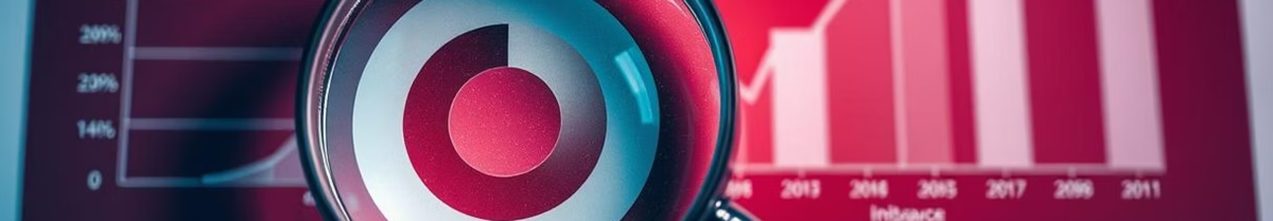
Why Consumers Choose Competitors
Learning from Market Leaders
Primary Decision Factors
CodeX Specific Strengths
Brand Reputation: 26.5%
Brand Reputation: 26.4% (Strong)
Taste/Flavor: 20.1%
Availability: 19.9% (Good)
Availability: 19.1%
Taste: 18.6% (Competitive)
Effectiveness: 17.5%
Effectiveness: 17.9% (Above average)
Price: 16.8%
Shruti Jain

Slide 9

Purchase Behavior Analysis
Where & When Consumers Buy
Top Purchase Locations
Consumption Situations
Supermarkets: 44.9%
Sports/Exercise: 44.9%
Online Retailers: 25.5%
Studying/Working Late: 32.3%
Gyms & Fitness Centers: 19.6%
Social Outings/Parties: 14.9%
Local Stores: 8.1%
Limited Edition Appeal: 39.5% interested, 40.2% not interested. Insight: Balanced approach to limited editions needed.
Shruti Jain

Slide 10
Marketing Channel Effectiveness
Reaching Our Audience
Most Effective Channels
Brand Awareness
Heard of CodeX: 44.5%
Online Ads: 40.2%
Tried CodeX: 20.3% (of aware consumers)
TV Commercials: 26.9%
Outdoor Billboards: 12.3%
Positive taste experience: 62.0% (of trial users)
Print Media: 8.4%
Opportunity: Increase trial conversion rate.
Shruti Jain

Slide 11
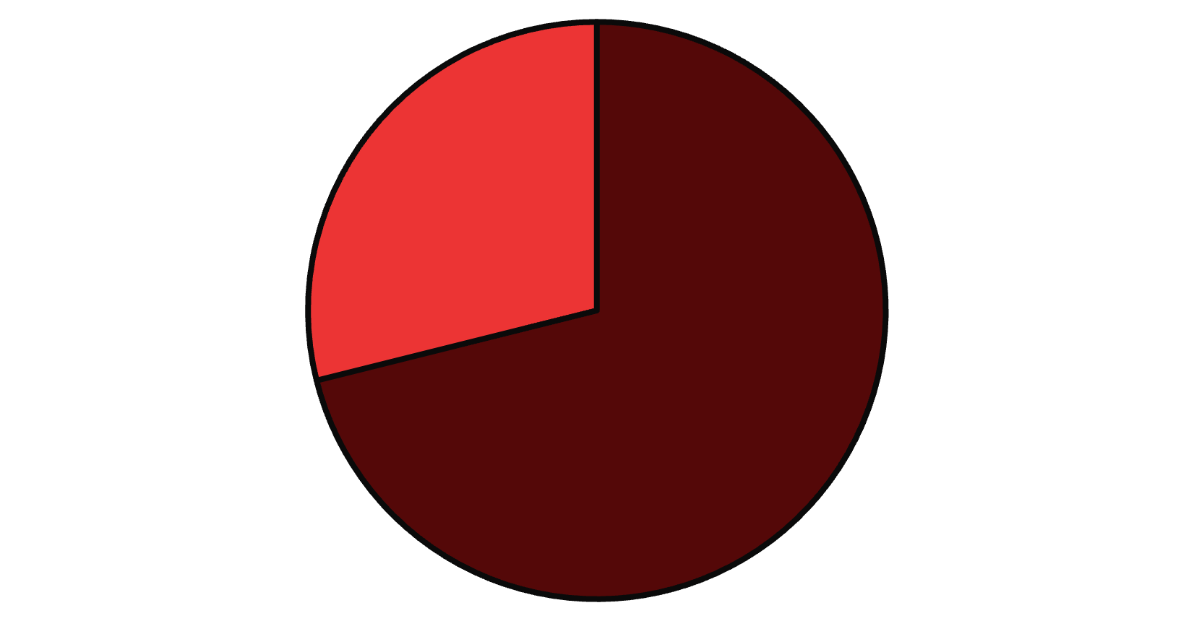
Geographic Market Analysis
City-wise Opportunities
Our market research reveals significant opportunities across key Indian cities:
Bangalore: 28.3% (Tier 1)
Hyderabad: 18.3% (Tier 1)
Mumbai: 15.1% (Tier 1)
Chennai: 9.4% (Tier 1)
Pune: 9.1% (Tier 2)
Tier 1 Cities
Tier 2 Cities
Tier 1 cities comprise the majority of our current market, guiding primary strategic focus areas for expansion.
Shruti Jain

Slide 12
CodeX Performance Dashboard
Our Current Standing
Health Concerns: 59.0% have health concerns about energy drinks
Why Choose CodeX?
1
Brand Reputation: 26.4%
2
Availability: 19.9%
3
Taste: 18.6%
4
Effectiveness: 17.9%
Price Positioning
50-99 INR range aligns with 42.9% preference
Currently competitive in taste ratings (3.2/5)
Packaging Preference
Limited edition has 39.5% appeal
Shruti Jain

Slide 13
Strategic Recommendations
Action Plan for Growth
Boost Online
Allocate 60% budget to digital channels for wider reach, building on strong online ad performance.
Enhance Availability
Target supermarkets & fitness centres, aligning with top purchase locations identified.
Taste Innovation
Prioritise flavour development to maintain competitive edge and leverage positive taste experience.
Geographic Expansion
Focus growth in key Tier 1 cities: Bangalore, Hyderabad, and Mumbai.
Drive Trial
Implement sampling campaigns in gyms and colleges to boost conversion rates.
Strengthen Brand
Leverage PR and influencer endorsements to enhance CodeX's reputation.
These phased actions will consolidate CodeX's market position and drive sustained growth in India.
Shruti Jain

Slide 14
Investment Priorities
Resource Allocation Strategy
Our strategic investment plan ensures optimal resource allocation for sustained growth and market leadership in India.
45%
25%
Digital Marketing
Traditional Marketing
Focus on online ads and social media for maximum reach.
Maintain presence through TV commercials and outdoor billboards.
20%
10%
Sampling & Events
Influencer Partnerships
Engage consumers at gyms, colleges, and sports events.
Leverage fitness and gaming communities for authentic endorsements.
Key Product Development Focus Areas
Caffeine Optimisation
Natural Ingredient Integration
Sustainable Packaging
Fine-tuning caffeine levels for enhanced, balanced energy delivery.
Adopting eco-friendly solutions to minimise environmental footprint.
Incorporating healthier, consumer-preferred natural components.
Shruti Jain

Slide 15





Success Metrics & KPIs: Measuring Progress
Key Performance Indicators
Brand Awareness
Target from 44.5%
Trial Rate
Target from 20.3%
Market Share
Target from 9.8%
Taste Rating
Maintain high score
Cities Presence
Expand geographic reach
Shruti Jain

Slide 16
Thank You
We appreciate your time and welcome any questions or further discussion on these insights.
Contact Information
Project Credits
Name: Shruti Jain
Data Analysis: SQL, Power BI
LinkedIn: https://www.linkedin.com/in/shruteejain369/
Visualization: Power BI Dashboard
Presentation: PowerPoint
Project held by: Codebasics
"Empowering CodeX's journey to energy drink market leadership through data-driven insights"
Shruti Jain

